Slide 1
24
7
30
Date
Volume
EQ – How do we solve volume word problems?
Notes:
Have the kids write down all of this and stop every step of the way.

Slide 2
Lesson objective
By the end of this lesson you will be able to;
- Solve volume word problems
Notes:
Lesson

Slide 3
24
7
30
Date
Volume
EQ – How do we solve volume word problems?
Example #1
A bin has a base of 22 cm by 22 cm and height 64 cm. How many litres of water would the bin hold (1000 cm³ = 1 L)?
C
U
B
E
S
Circle key numbers
Draw a diagram
Find the volume
Convert the units from cm³ to L
What is the CUBES strategy?
Underline the questions
Box any math action words
Evaluate (what steps do I take?)
Solve and check – Your turn!
22cm x 22cm x 64 cm = 30,967 cm³
30,967 cm³ ÷ 1000 = 30.967 L
Notes:
Have the kids write down all of this and stop every step of the way.

Slide 4
24
7
30
Date
Volume
EQ – How do we solve volume word problems?
Example #2
A milk carton has a base of 10 cm by 10 cm and a height of 20 cm. How many litres of milk will the carton hold (1000 cm3 = 1 L)?
C
U
B
E
S
Circle key numbers
Draw a diagram
Find the volume
Convert the units from cm³ to L
Underline the questions
Box any math action words
Evaluate (what steps do I take?)
Solve and check – Your turn!
10cm x 10cm x 20cm = 2,000 cm³
2,000 cm³ ÷ 1000 = 2 L
Notes:
Lesson objective (EQ)

Slide 5
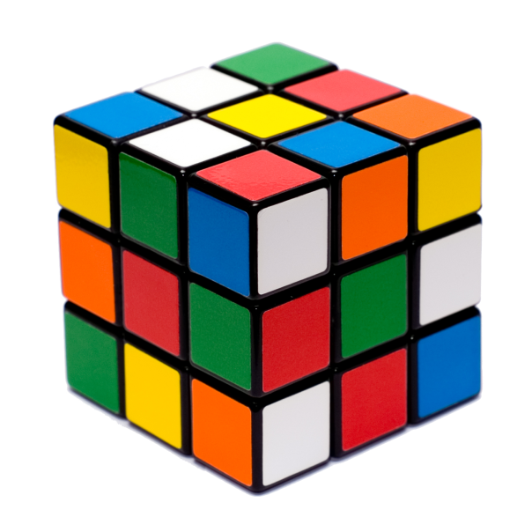



Practice
Ex. 8.3 page 106
(we have already done question 1)
Notes:
Independent practice

Slide 6
Closure
Your summary is your exit pass
Notes:
Closure

